Slide 1
Hybrid recommender Systems with LightFM
CSCI E-82 Tool Topic
Fall 2024
Sarah Pierro and Yuvraj Puri

Slide 2
Outline
Recommender systems overview
Cold-start problem
Types of recommender systems
Production-level
LightFM
Million Song hybrid recommender system workflow
Experience with LightFM
Example

Slide 3



Recommendation systems: what are they?
Basic premise: “What option is best suited for me / end user?”
Uses: shopping, browsing, consuming media (TV, movies, YouTube)
Considerations: “cold start problem”
Notes:
RecSys - designed to predict user preferences and suggest items (like products, movies, music, etc.) that are most relevant to them. These systems personalize experiences by analyzing user behavior, item characteristics, and interactions between users and items. Helpful for personalizing the experience, for being efficient, and for helping make users want to engage with a platform.

Slide 4

“Cold start”
Users: There is no user history for a new user. The system doesn’t know preferences of the user to make recommendations with. Items: Lack of interaction data for a new product. Without it, how do you know who to recommend it to or when to recommend it?
Strategies to deal with cold start: (User, Item) - Use hybrid recommender - “Preference elicitation” / onboarding: questionnaire - Demographic-based recommendations
- Leveraging metadata (genre, tags) - Popularity-based recommendations: recommend to users based on well-received items similar to new item
Notes:
Opened Amazon on incognito so theoretically, should have had no user data. How did it provide recommendations?
New users often lack interaction data, making it difficult to generate personalized recommendations. Use explicit feedback - onboarding questionnaire - to obtain preferences. Use this information to recommend items based on matching metadata (content based filtering), or by matching popular items in categories of interest perhaps.
Use demographic or contextual data (e.g., age, location, gender, device) to find similar users and recommend what they like. Monitor early user behavior: Search queries, clicks, or time spent on pages. Recommend items based on these implicit signals.
Use item features (e.g., genre, tags, attributes) to recommend the item to: Users who have interacted with similar items. Users whose profiles match the item's metadata.

Slide 5
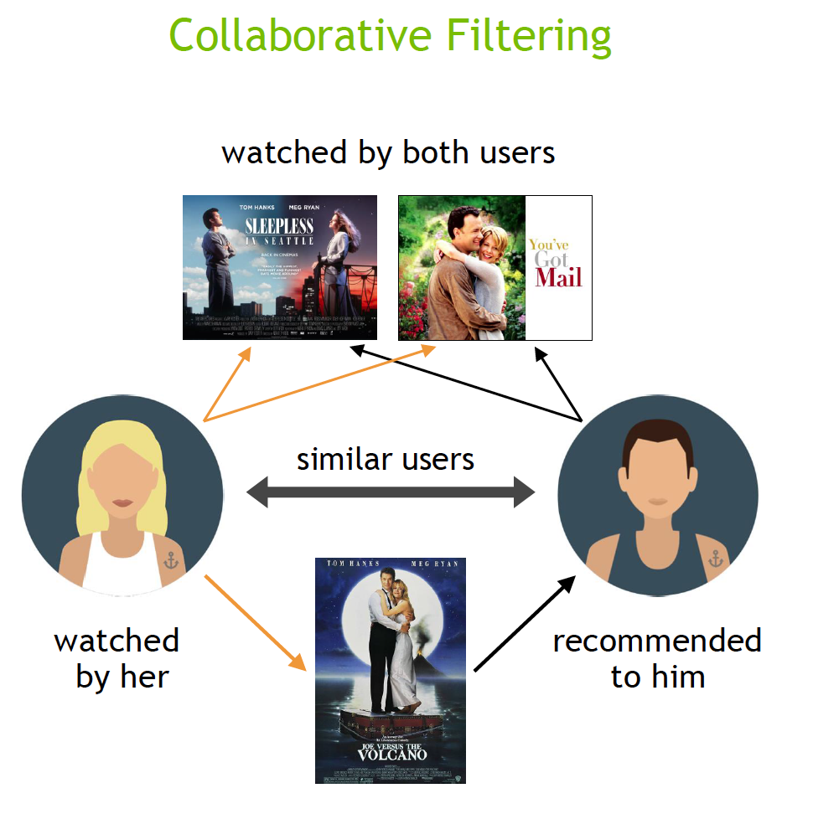
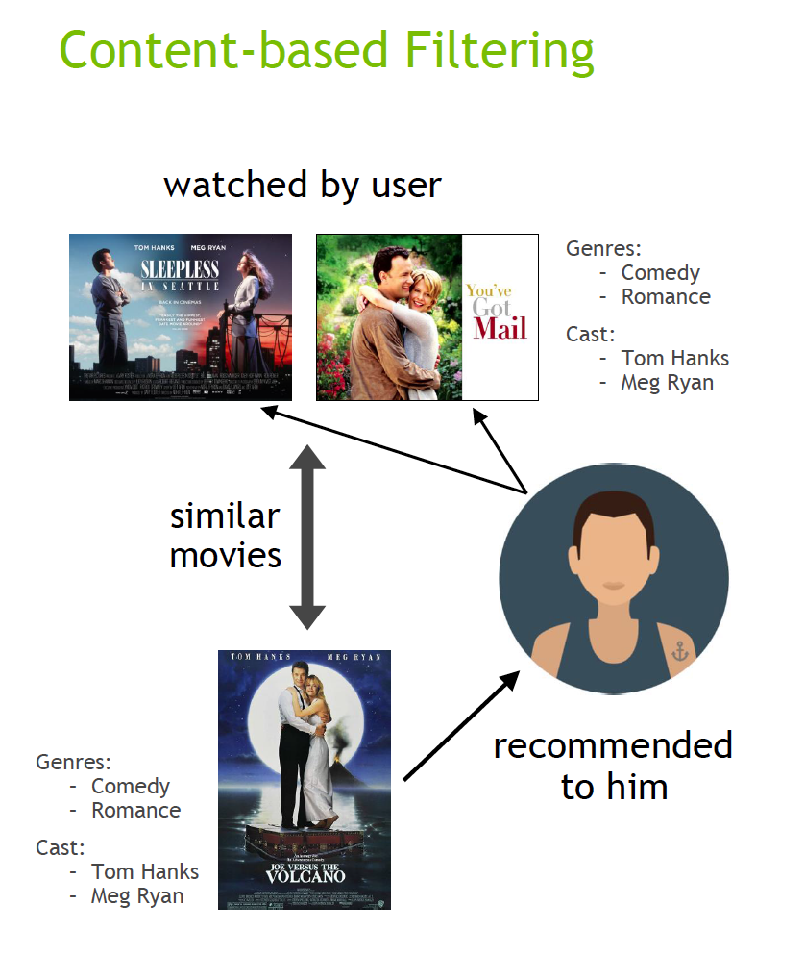
Types of recommender systems
Collaborative filtering: Uses interaction data to learn patterns and make recommendations → “users who like item X also like item Y”
Content-based filtering: Relies on metadata/features to
Hybrid recommender approaches: combine above approaches for more comprehensive recommendation algorithm
Deep neural network approaches: VAE-CF, Wide & Deep, DLRM,
More in depth, subsets of Collaborative filtering:
Model based filtering
Memory / Session based filtering
AND PLENTY MORE!
Notes:
Collaborative filtering: Collaborative filtering algorithms recommend items (this is the filtering part) based on preference information from many users (this is the collaborative part). This approach uses similarity of user preference behavior, given previous interactions between users and items, recommender algorithms learn to predict future interaction. These recommender systems build a model from a user’s past behavior, such as items purchased previously or ratings given to those items and similar decisions by other users. The idea is that if some people have made similar decisions and purchases in the past, like a movie choice, then there is a high probability they will agree on additional future selections. For example, if a collaborative filtering recommender knows you and another user share similar tastes in movies, it might recommend a movie to you that it knows this other user already likes. Collaborative filtering can struggle with the cold start problem because it relies heavily on historical interaction data (e.g., ratings, clicks, purchases) to make recommendations - you need user interactions or item interactions to make some of these recommendations.
Content-based filtering: Content filtering, by contrast, uses the attributes or features of an item (this is the content part) to recommend other items similar to the user’s preferences. This approach is based on similarity of item and user features, given information about a user and items they have interacted with (e.g. a user’s age, the category of a restaurant’s cuisine, the average review for a movie), model the likelihood of a new interaction. For example, if a content filtering recommender sees you liked the movies You’ve Got Mail and Sleepless in Seattle, it might recommend another movie to you with the same genres and/or cast such as Joe Versus the Volcano.
VAE-CF: Variational Autoencoder for Collaborative filtering. An autoencoder neural network reconstructs the input layer at the output layer by using the representation obtained in the hidden layer. An autoencoder for collaborative filtering learns a non-linear representation of a user-item matrix and reconstructs it by determining missing values. The model consists of two parts: the encoder and the decoder. The encoder is a feedforward, fully connected neural network that transforms the input vector, containing the interactions for a specific user, into an n-dimensional variational distribution. This variational distribution is used to obtain a latent feature representation of a user (or embedding). This latent representation is then fed into the decoder, which is also a feedforward network with a similar structure to the encoder. The result is a vector of item interaction probabilities for a particular user.
Wide & Deep: Wide & Deep refers to a class of networks that use the output of two parts working in parallel—wide model and deep model—whose outputs are summed to create an interaction probability. The wide model is a generalized linear model of features together with their transforms. The deep model is a Dense Neural Network (DNN), a series of five hidden MLP layers of 1024 neurons, each beginning with a dense embedding of features. Categorical variables are embedded into continuous vector spaces before being fed to the DNN via learned or user-determined embeddings. It’s good for recommendation work because it provides two avenues of learning patterns in the data, “deep” and “shallow”. The complex, nonlinear DNN is capable of learning rich representations of relationships in the data and generalizing to similar items via embeddings, but needs to see many examples of these relationships in order to do so well. The linear piece, on the other hand, is capable of “memorizing” simple relationships that may only occur a handful of times in the training set. In combination, these two representation channels often end up providing more modelling power than either on its own
DLRM: a deep learning-based model for recommendations introduced by Facebook research. It’s designed to make use of both categorical and numerical inputs that are usually present in recommender system training data. To handle categorical data, embedding layers map each category to a dense representation before being fed into multilayer perceptrons (MLP). Numerical features can be fed directly into an MLP. At the next level, second-order interactions of different features are computed explicitly by taking the dot product between all pairs of embedding vectors and processed dense features. Those pairwise interactions are fed into a top-level MLP to compute the likelihood of interaction between a user and item pair. Compared to other DL-based approaches to recommendation, DLRM differs in two ways. First, it computes the feature interaction explicitly while limiting the order of interaction to pairwise interactions. Second, DLRM treats each embedded feature vector (corresponding to categorical features) as a single unit, whereas other methods (such as Deep and Cross) treat each element in the feature vector as a new unit that should yield different cross terms. These design choices help reduce computational/memory cost while maintaining competitive accuracy.
Source: https://www.nvidia.com/en-us/glossary/recommendation-system/

Slide 6

Production level recommender systems (basic means)
Some means they use include:
Candidate generation
Explicit feedback
Implicit feedback
Ranking
Examples: how do they use these?
Netflix
Notes:
Candidate generation, explicit feedback and implicit feedback
Netflix example: CG - Selects a subset of movies the user might like based on genres, user behavior, or similar users. EF - uses star ratings provided by users to directly inform recommendations. IF - Leverages watch history, time spent on shows, and search queries to infer user preferences. Ranking - finding the “best recommendation” using various data to inform a ranking for the better or best item.
Candidate generation: Candidate generation is a component in modern recommendation systems aimed at efficiently narrowing down a vast item pool (e.g., from millions to hundreds) through metadata-based filters or k-nearest neighbor techniques. This initial stage involves trading off precision for efficiency, enabling a substantial reduction in the search space.
Ranking: ranking, a more precise process, involves sorting and selecting top recommendation candidates. Rather than finding optimal recommendations, find “best” recommendations or the one that is better than others. You can make this ranking with data like user persona (demographics, price propensity), item metadata (attributes, engagement statistics), cross features (interaction between feature pairs), and media embeddings
https://medium.com/@zaiinn440/one-stop-guide-for-production-recommendation-systems-9491f68d92e3
Explicit feedback: Explicit feedback is direct input from users expressing their preferences or opinions about items. E.g. ratings, reviews, expressions of Likes/Dislikes
Implicit feedback: Implicit feedback is information inferred from user behavior rather than directly provided by users. E.g. looking at the pages they’ve clicked, viewed, products someone has bought, how long they spend on a page - all to gather an idea of what to get them. Lacks issues with bias as it gathers information about a user’s natural behavior.

Slide 7

LightFM
Library to implement recommendation algorithms
Key features:
Makes building hybrid recommendation systems convenient
Hybrid matrix factorization model
User interactions and user/item metadata
Can model implicit or explicit feedback
Able to incorporate features on items and users
Efficient implementation of Weighted Approximate-Rank Pairwise (WARP) and Bayesian Personalized Ranking (BPR) loss
How it works:
Maps users and items into a shared latent space
Choice of implicit (e.g., clicks or views) or explicit feedback (e.g., ratings or play counts)
Choice of loss function
Uses features of items and users to improve recommendations
Performs well on cold-start recommendations
Existing users: use user-item interactions to make predictions
New users: use features about user to make predictions
https://github.com/lyst/lightfm
Notes:
LightFM is a library for implementing a variety of recommendation algorithms. It’s particularly powerful for building hybrid recommender systems, which combine user-item interaction data with metadata about users and items. This makes it effective not only for personalized recommendations but also for addressing the cold-start problem.
The library supports both implicit feedback (like clicks) and explicit feedback (like user ratings), offering versatility for solving different recommendation challenges.
To train a recommender system with LightFM, we use a utility matrix, which captures user-item interactions (e.g., how often a user listens to a song). At its core, LightFM uses a hybrid matrix factorization model, which maps both users and items into a shared latent space. This latent space is a high-dimensional representation where each user and item is represented as a vector of numbers. These vectors encode hidden patterns and relationships that drive user-item interactions. The hybrid aspect of the model comes from its ability to combine the utility matrix with additional information from user and item feature matrices—for example, user demographics or preferences and item attributes like genre or artist. By incorporating this extra information, LightFM can make more accurate and personalized recommendations, even for new users or items.
A hybrid recommender system can be great in scenarios where traditional systems might fall behind. For existing users, it leverages user-item interaction data like play counts to generate recommendations. For new users, it relies on metadata, such as genre preferences, to make predictions. This makes hybrid systems effective in solving the cold-start problem.
Finally, LightFM is built for efficiency and scalability. Its implementation of Weighted Approximate-Rank Pairwise loss and Bayesian Personalized Ranking loss uses sampling to avoid computing all pairwise comparisons, ensuring the model is computationally efficient even with large datasets.

Slide 8
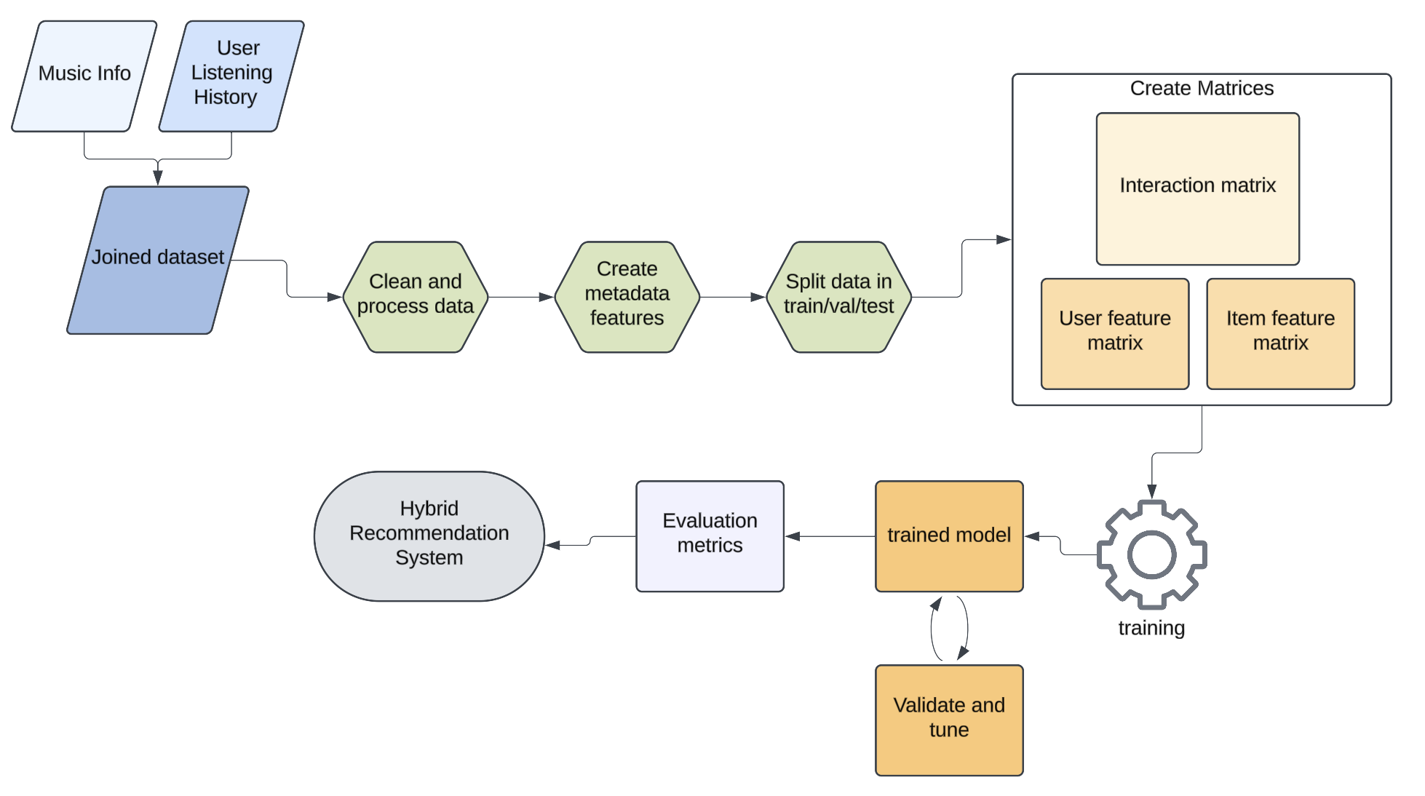
LightFM on Million Song + Spotify + LastFM dataset
Data: Music streaming service with user listening history and song metadata
Goal: Recommend top K songs based on previous listens (interactions), where available, and additional features
Notes:
For our demo, we used Kaggle data on users’ music streaming history and song information, such as danceability and tempo. The goal of our recommender system was to recommend the top K songs for a given user based on their preferences, song metadata, and previous listens (where available).
The process involved several steps. Like many modeling tasks, the bulk of the work was in preparing the data, engineering features, and creating the interaction, user feature, and item feature matrices needed for model training. As mentioned earlier, LightFM leverages these user and item feature matrices, mapping them into a shared latent space using hybrid matrix factorization. Incorporating this additional information is what makes the system hybrid, and how the data is represented is key to LightFM’s computational efficiency.
We split the data into train, validate, and test sets to evaluate and iterate on the model, ensuring it performs well on unseen data. Finally, we trained, validated, and tested our recommender system until we achieved results we were happy with.

Slide 9
Experience with LightFM
Computational speed/Scalability
Held true to being scalable - fast training on large data (>1M rows), and seemed to handle as much data as Colab allowed
Ease of use
Minimal lines of code required to initialize and fit model
Data Preparation
Hardest part is data cleaning and preparation
Engineering additional features for user and item metadata worthwhile time investment
Model performance
Able to achieve good AUC
Precision and recall more difficult to optimize, balancing number of top recommendations and track sample size
Likely gets easier with experience :-)
Notes:
Our experience with LightFM was pretty positive across the board.
Even working with a million rows of data, training is fast. In fact, we seemed to be more restricted by Colab’s ability to manipulate the volume of data to do some of the feature engineering than we were with LightFM’s training times.
Initializing a model, training, and generating predictions for recommendations is implemented in just a few lines of code.
The hardest part was data preparation and understanding the correct representation of the data needed.
Ultimately, we found that using a hybrid recommender system with the Kaggle dataset we worked on delivered strong performance, particularly in terms of AUC, which is a great measure of recommendation quality.

Slide 10

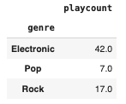
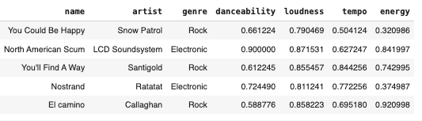
Example
User preferences
User
Listens to rock, electronic, and pop music
Top 5 recommendations
Notes:
Here’s an example recommendation made on a test user from this dataset. To incorporate user metadata in our hybrid recommendation system, we engineered a feature made up of users’ genre preferences. This user, who listens to Rock, Electronic, and pop music, had top 5 recommendations of electronic and rock songs with similar loudness, and danceability, and tempo.
Image: https://www.flaticon.com/free-icon/user-with-headphones_32382

Slide 11
Resources
LightFM docs
Metadata Embeddings for User and Item Cold-start Recommendations
Million Song + Spotify + LastFM Kaggle dataset
Million Song Dataset (additional info)
Hybrid Recommender Systems with LightFM Medium Article
https://medium.com/@zaiinn440/one-stop-guide-for-production-recommendation-systems-9491f68d92e3
https://www.nvidia.com/en-us/glossary/recommendation-system/
https://medium.com/@markmilankovich/the-cold-start-problem-for-recommender-systems-89a76505a7

Slide 12
Thank you!

